Slide 1

How the Web Works: Unpacking the Internet
Welcome! Ever wondered what happens when you type a website address into your browser? Join us on a journey to demystify the magic behind your daily online experience.
https://github.com/naimulislammehedi/Front-End-Web-Development © Naimul Islam Mehedi

Slide 2
Introduction
The Internet is a Global Network, The Web is How We Use It.
Think of the internet as the roads and highways connecting cities, while the World Wide Web (the web) is the system of traffic rules, signs, and destinations that allows you to navigate and find what you need. It's a vast, interconnected library waiting for you to explore.
https://github.com/naimulislammehedi/Front-End-Web-Development © Naimul Islam Mehedi

Slide 3



Clients, Servers, and the HTTP Dance
Clients: Your Device & Browser
Servers: The Information Hubs
HTTP/HTTPS: The Conversation Protocol
This is you! Your computer, phone, or tablet running a web browser (Chrome, Firefox, Safari) acts as the "client." Its job is to request information.
Powerful computers storing website data (files, images). Always online, servers listen for client requests and serve up the desired information.
This is the "language" clients and servers use to communicate. HTTP (Hypertext Transfer Protocol) dictates how requests and responses are formatted.
https://github.com/naimulislammehedi/Front-End-Web-Development © Naimul Islam Mehedi

Slide 4
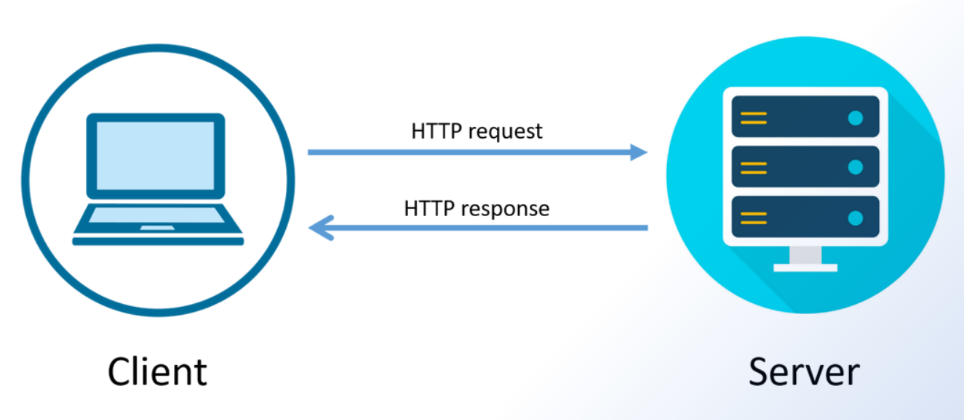
The Request-Response Cycle
1. You type google.com into your browser (the client).
3. The server finds the files (HTML, CSS, JavaScript) and sends them back to your browser with an HTTP response.
2. The browser sends an HTTP GET request to Google's server, asking for the main page.
4. Your browser assembles these files and displays the webpage for you.
https://github.com/naimulislammehedi/Front-End-Web-Development © Naimul Islam Mehedi

Slide 5
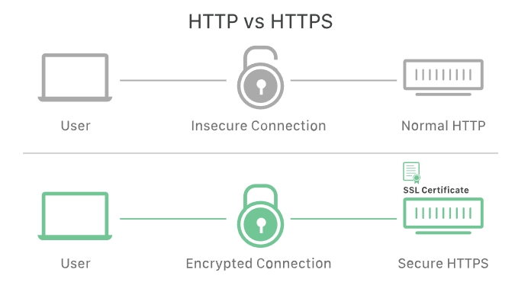
The 'S' in HTTPS: Security Matters
HTTPS stands for "HTTP Secure." It's an encrypted version of the protocol, creating a secure tunnel for data exchanged between your client and the server.
This encryption is vital for protecting sensitive information like passwords, banking details, and credit card numbers from prying eyes. Always look for the lock icon in your browser's address bar, indicating a secure connection.
https://github.com/naimulislammehedi/Front-End-Web-Development © Naimul Islam Mehedi

Slide 6


Static vs. Dynamic Websites
Websites can be categorized by how their content is built and delivered.
Static Websites
Dynamic Websites
Fixed content, delivered exactly as stored. Like a printed brochure, everyone sees the same information. Built with HTML, CSS, and some JavaScript. Ideal for simple informational sites.
Content generated in real-time, displaying different information for different users. Think of a personalized social media feed. Uses front-end and back-end technologies to pull data from databases.
https://github.com/naimulislammehedi/Front-End-Web-Development © Naimul Islam Mehedi

Slide 7



Understanding Web Development Roles
Imagine a restaurant to understand the different areas of web development:
Back-End: The Kitchen
Front-End: The Dining Room
Full-Stack: The Manager
The "behind-the-scenes" machinery. This includes the server, application logic, and database. It handles user authentication, data processing, and data retrieval.
Everything the user sees and interacts with directly in the browser. Focuses on user experience (UX) and user interface (UI) through HTML, CSS, and JavaScript.
A developer comfortable working on both the front-end and back-end. They understand both the "kitchen" and "dining room" and can build a complete web application from start to finish.
https://github.com/naimulislammehedi/Front-End-Web-Development © Naimul Islam Mehedi

Slide 8
Key Technologies at a Glance
Front-End Technologies
Back-End Technologies
Protocols & Concepts
HTTP/HTTPS: Communication rules for the web.
HTML: HyperText Markup Language, for structuring content.
Languages: Python, Node.js, Java, Ruby, PHP.
Client-Server Model: How devices and servers interact.
CSS: Cascading Style Sheets, for styling and layout.
Databases: MySQL, PostgreSQL, MongoDB.
JavaScript: For interactivity and dynamic content.
https://github.com/naimulislammehedi/Front-End-Web-Development © Naimul Islam Mehedi

Slide 9

The Ever-Evolving Web
The web is a constantly evolving ecosystem. From static pages to complex web applications, new technologies and standards emerge regularly.
Understanding these foundational concepts provides a strong base for navigating and appreciating the incredible complexity and utility of the online world.
https://github.com/naimulislammehedi/Front-End-Web-Development © Naimul Islam Mehedi

Slide 10

Key Takeaways & Next Steps
Client-Server Foundation
HTTP/HTTPS Communication
Your browser requests, servers deliver.
The language of the web, with "S" for security.
Static vs. Dynamic
Front-End & Back-End
Fixed content vs. real-time generated experiences.
What you see and what happens behind the scenes.
https://github.com/naimulislammehedi/Front-End-Web-Development © Naimul Islam Mehedi

